Slide 1
Intro to Data Science Final Project
Michael Wakefield

Slide 2
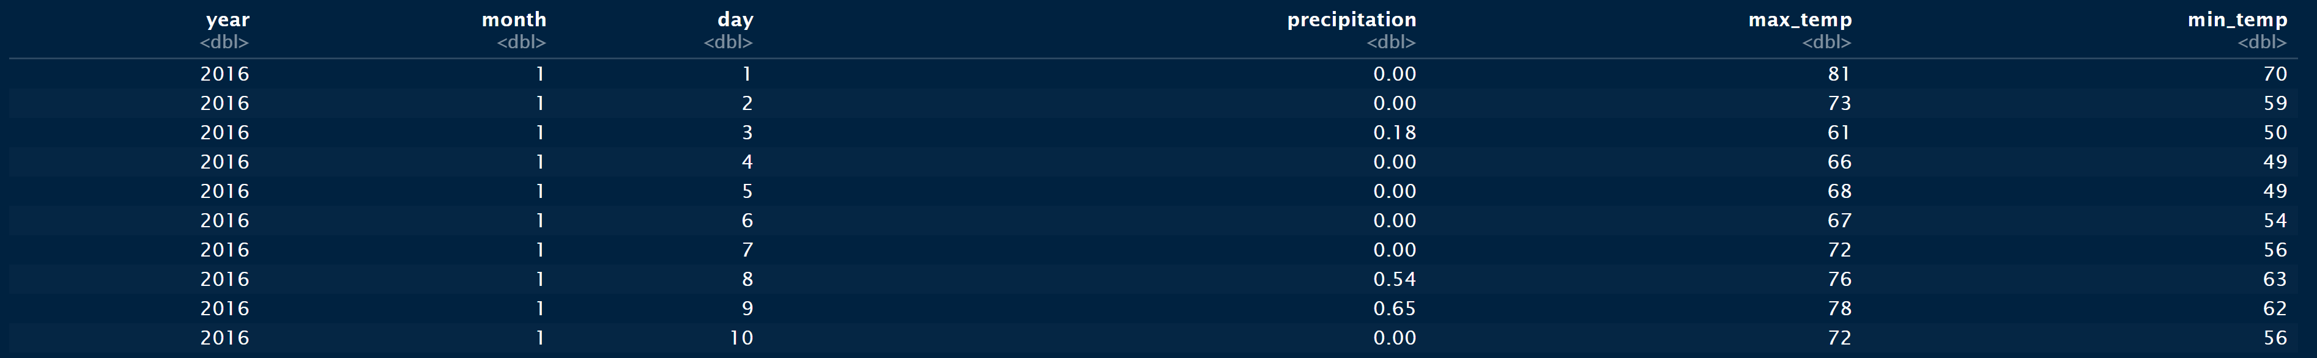
Dataset
Tampa’s Weather
tpa_weather_16_17.csv
Sample Data

Slide 3

Prerequisites
Packages used
tidyverse
ggplot2
dplyr

Slide 4
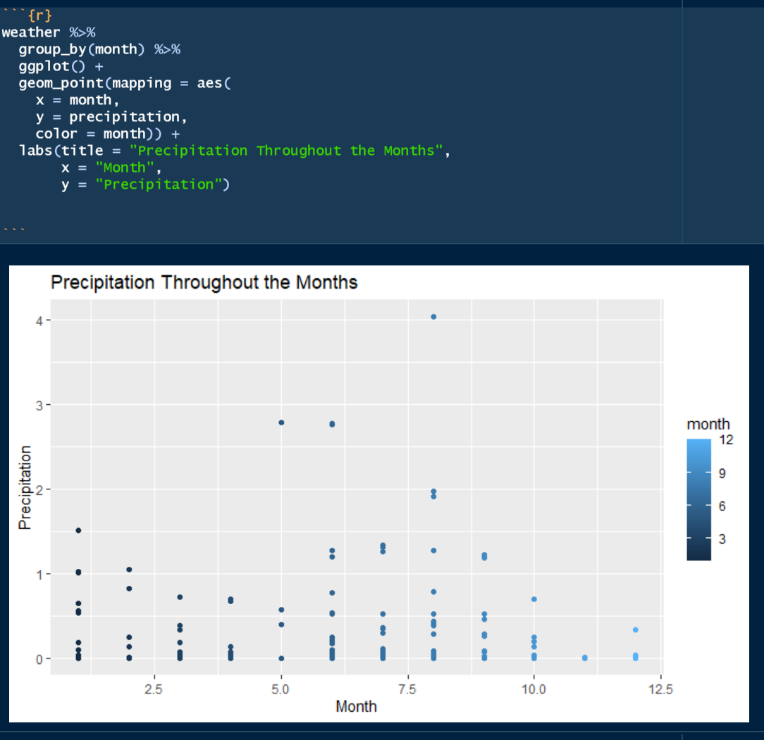
Exploratory Data Analysis
Univariate Exploration
Precipitation

Slide 5
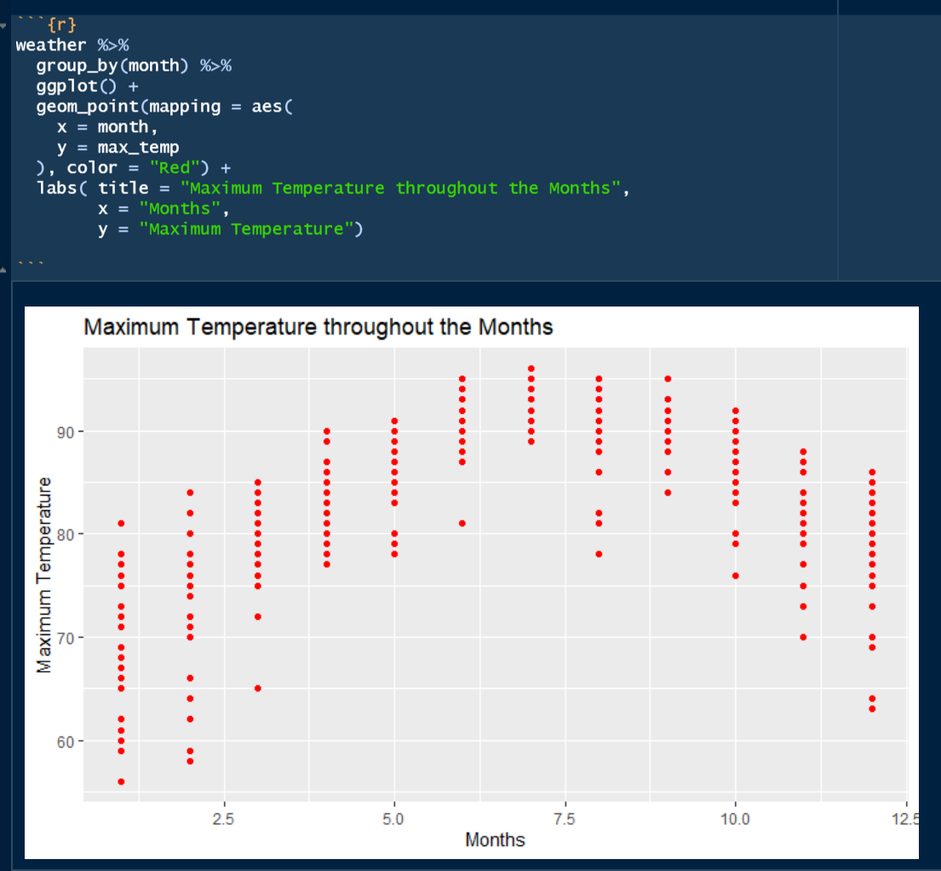
Exploratory Data Analysis
Univariate Exploration
Temperature

Slide 6
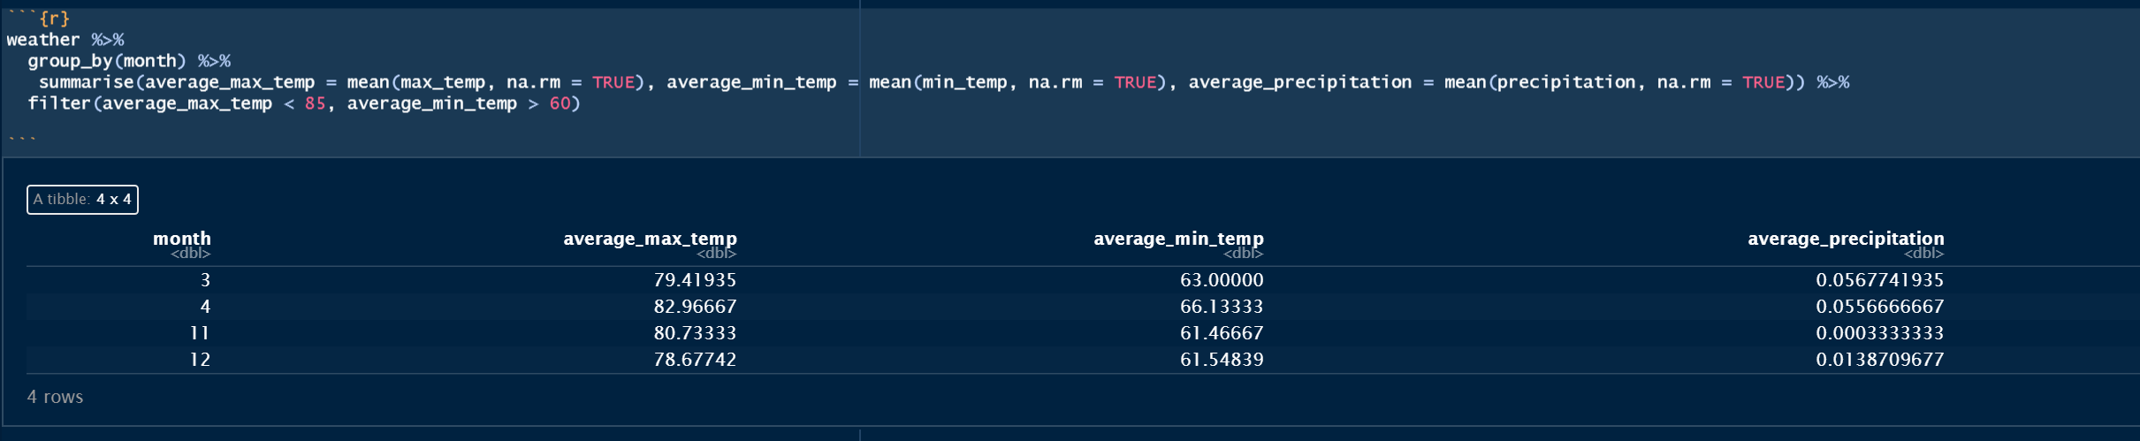
Research Questions
When is it the best time to travel to Tampa based on the weather?
Best Months: March, April, November, & December

Slide 7
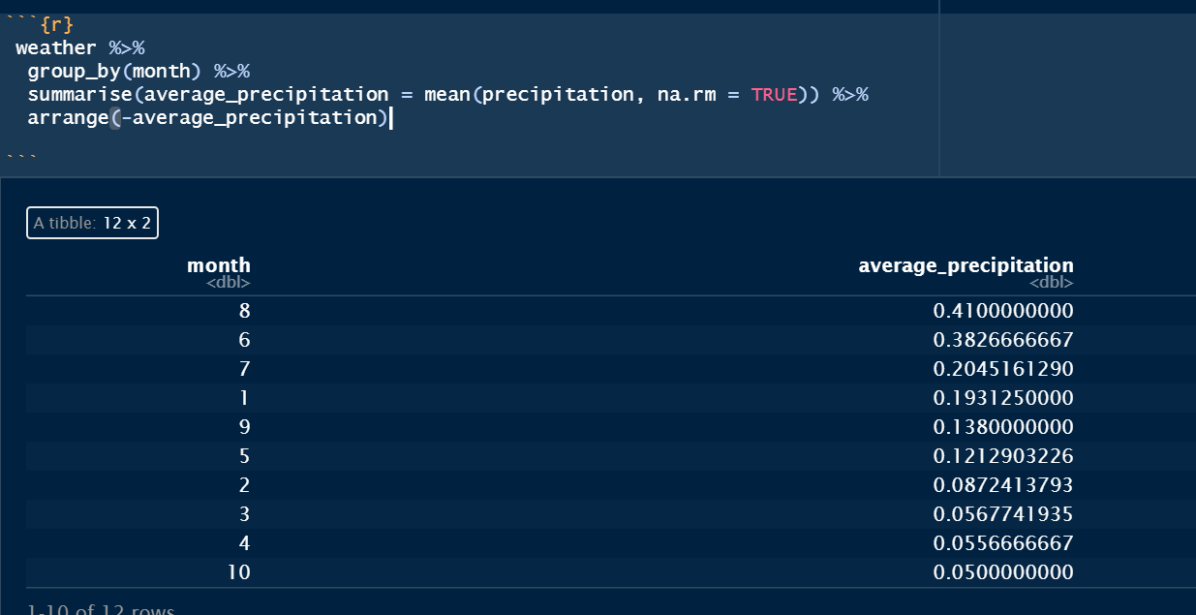
Research Questions
Which month has the greatest precipitation?
Most rainfall - August

Slide 8

Conclusion
R Studio
Create Graphs
Filter Data
Create Variables in Dataset
Tampa’s Weather
Best Months to Visit
Month with most Rain

Slide 9
Video
https://youtu.be/_9otQzIfBu4

